Slide 1
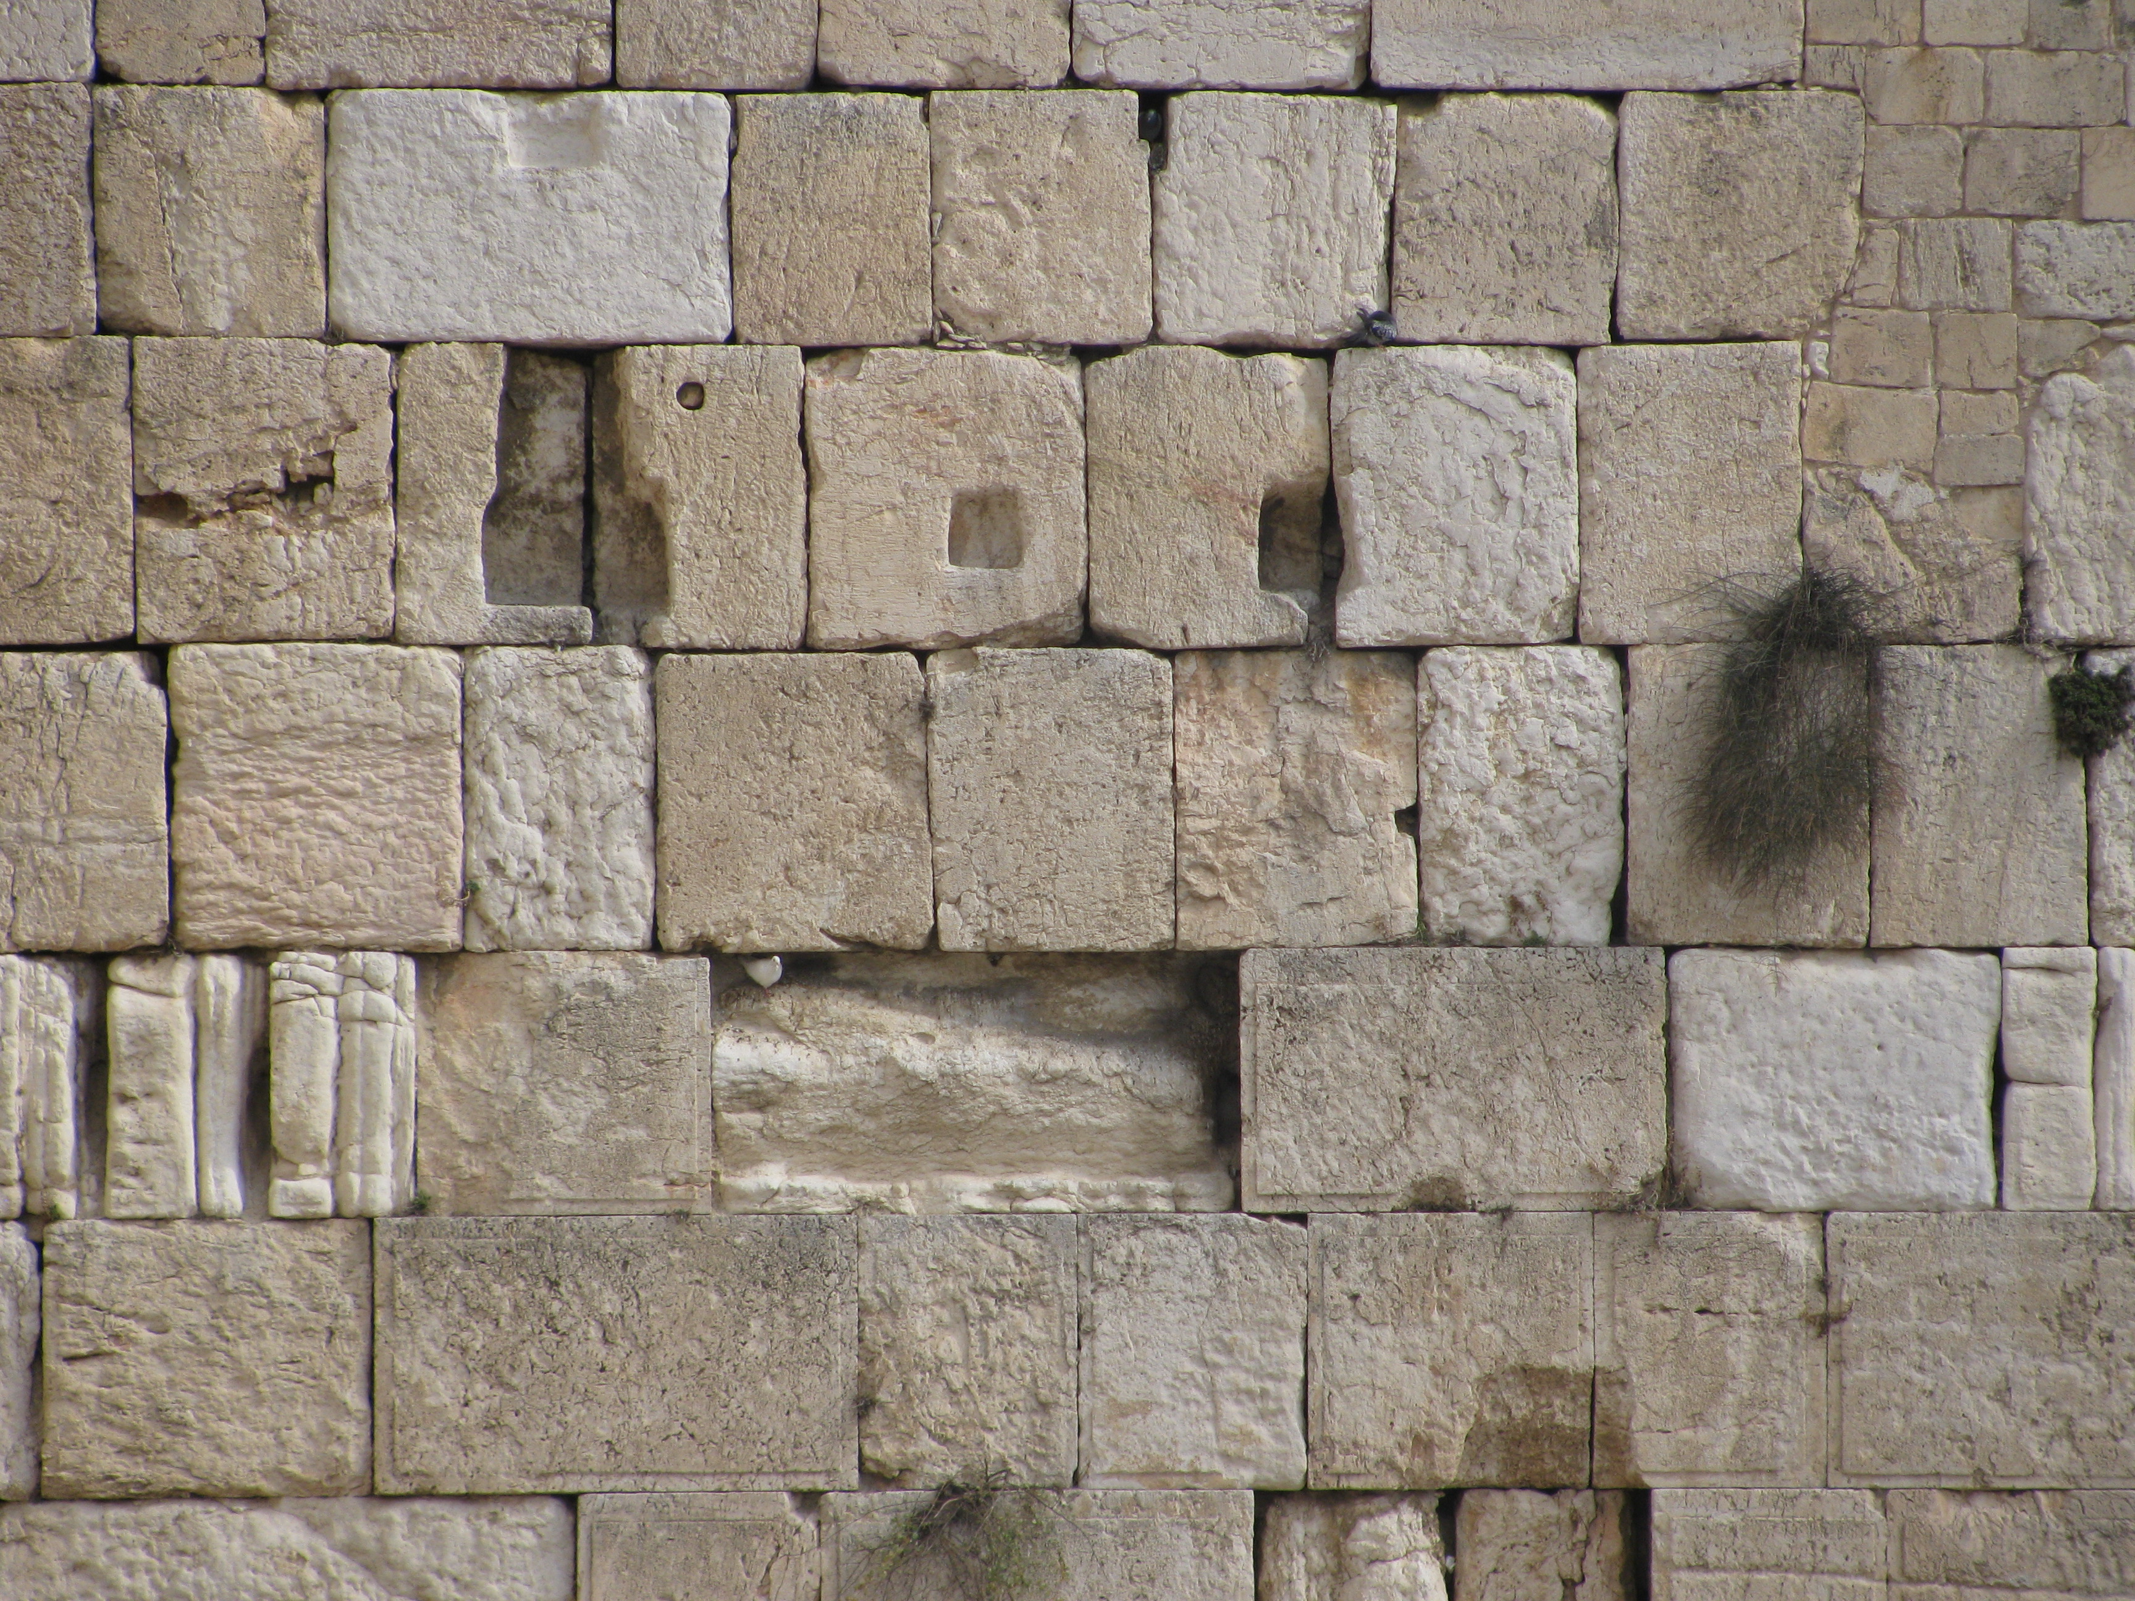

Slide 2
Ezekiel 22:30 “And I looked for a man to build up the wall and to stand in the breach before Me for the land that I may not destroy it: I found none.”

Slide 3
God’s people need to be concerned about the health of the expression of their faith.

Slide 4
The search.
“And I looked for a man...”

Slide 5
2 Chronicles 16:9 “For the eyes of the Lord run to and fro throughout the whole earth, to give strong support to those whose heart is blameless toward him.”

Slide 6
The call.
“...to build up the wall and to stand in the breach before Me for the land...”

Slide 7
Proverbs 25:28 “A man without self-control is like a city broken into and left without walls.”

Slide 8
The warning.
“...that I may not destroy it...”

Slide 9
Revelation 2:2-5 “ ‘I know your works, your toil and your patient endurance, and how you cannot bear with those who are evil, but have tested those who call themselves apostles and are not, and found them to be false. I know you are enduring patiently and bearing up for my name’s sake, and you have not grown weary. But I have this against you, that you have abandoned the love you had at first. Remember therefore from where you have fallen; repent, and do the works you did at first. If not, I will come to you and remove your lampstand from its place, unless you repent.

Slide 10
The result.
“...I found none.”

